Slide 1
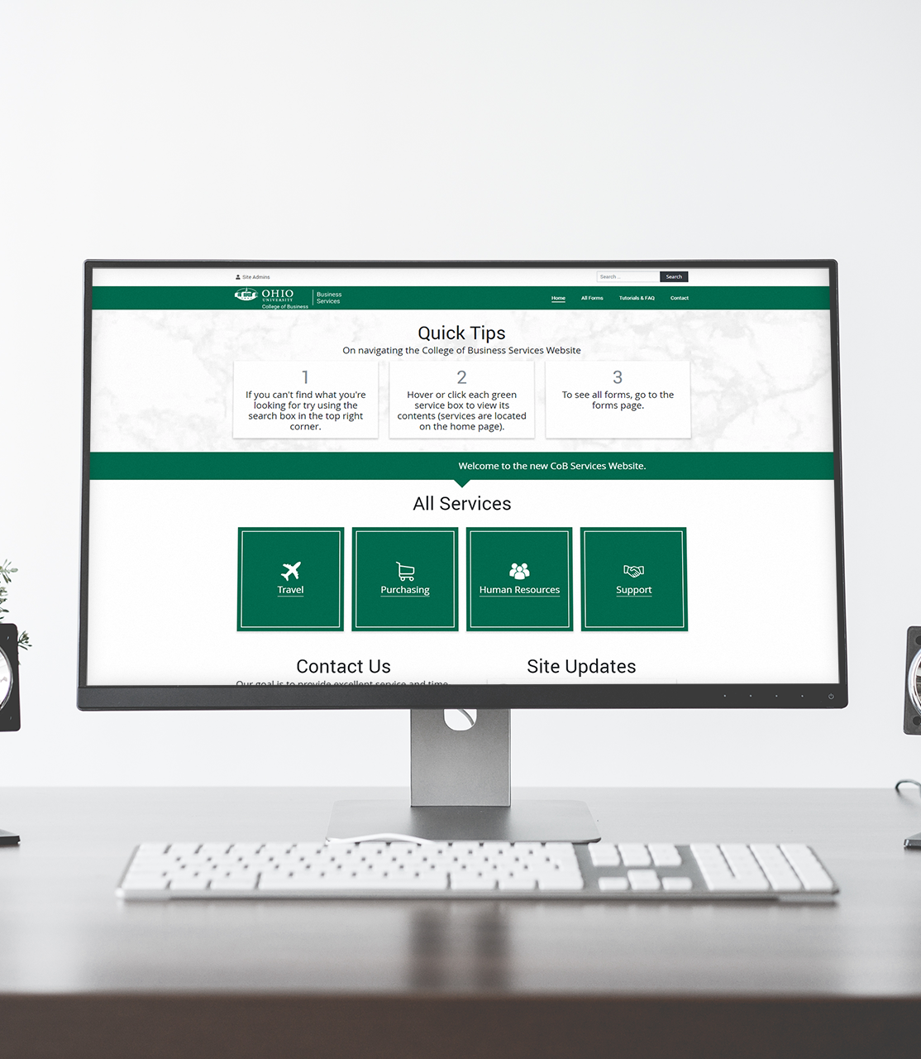
Business Services
Forms, Approvals, & Navigation

Slide 2
How to Interact with Forms
1
2
Two ways to interact with forms:
Logging into cobservices.com backend.
Click “Site Admins” > login using unique credentials > select “Workflow” > select “Inbox”
Clicking entry hyperlinks in your email inboxes.
Cobservices.com

Slide 3
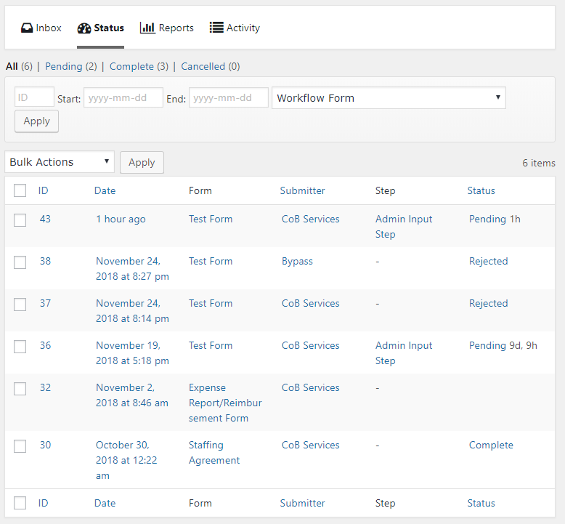
View the Status of Forms
Login to cobservices.com backend.
Click “Site Admins” > login using unique credentials > select “Workflow”
Select “Inbox” to see forms requiring your attention.
Select “Status” to see all forms. You can filter by form type, and search any field.
2
Cobservices.com

Slide 4
Form Questions & Notifications
Applies to: Chairs, Program Directors, Deans, & Associate Deans.
For Questions:
Fill in the “Answer” textbox
Press “Submit”
For Notifications:
Select the “Acknowledgement” box.
Press “Submit”
Continue to Approval step (next slide).

Slide 5
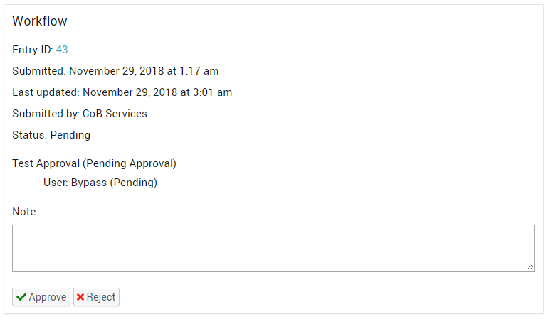
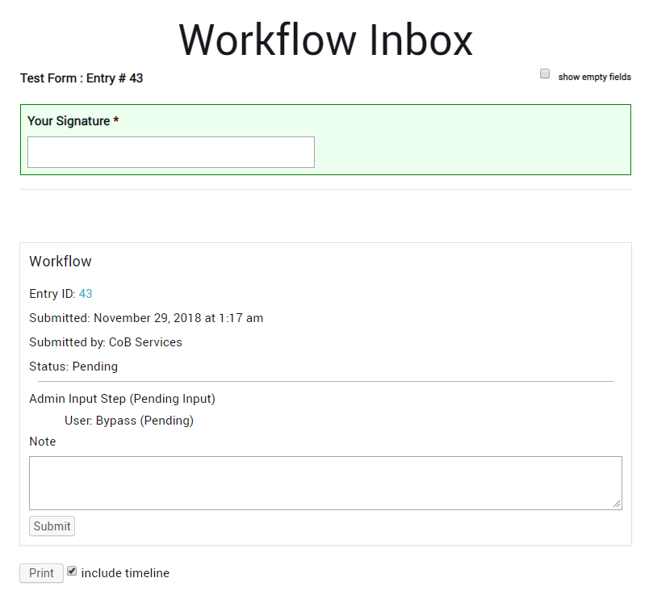
Form Approval
1
Applies to: Chairs, Program Directors, Deans, & Associate Deans.
Step 1:
Approve / Deny / Revert the form. These options appear at the bottom of the form.
Step 2:
Sign the form. This box appears at the bottom of the form and has a green background surrounding the area.
Press the “Submit” button.
2
Cobservices.com

Slide 6
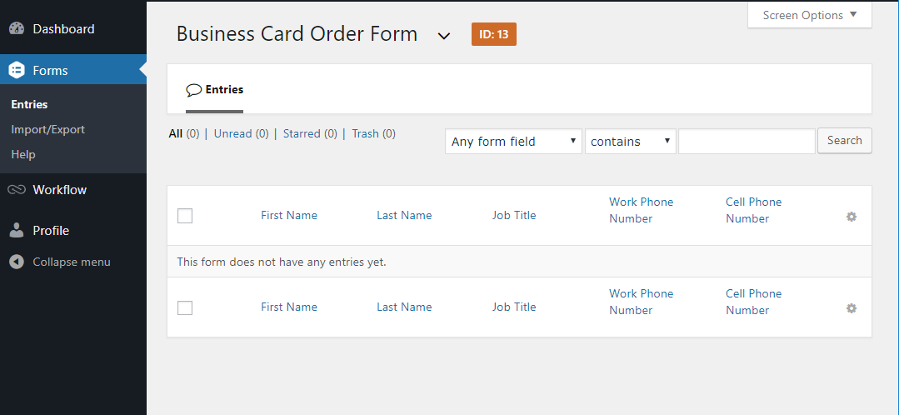
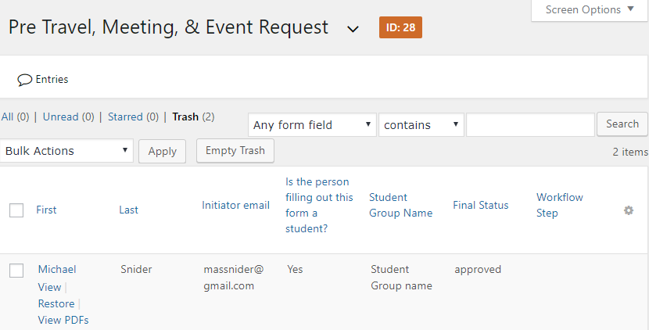
PDF form processing
Applies to: Financial Processors.
You will receive after the from has been completed and/or approved with a PDF document attached.
Please download the document for future processing.
If you lose the PDF link follow the steps below.
Finding a PDF:
Login to cobservices.com backend.
Select “Forms” > “Entries”.
Select the form type you want to view entries in.
Hover over the entry and select “View PDFs”
3
4

Slide 7
Thank You
Cat Mail: ms052916
cobservices.com

